Slide 1


ECEN 403 Final Presentation Team 12: Wind Power Christian Kirk, Lyndon Li, Samuel Tando Sponsor: Wonhyeok Jang

Slide 2
Problem Overview
Problem: Nonrenewable sources of power are leading to climate change and are finite.
Solution: need to move towards renewable, clean power in the future
Our wind power system will be used to educate kids about how renewable power systems work

Slide 3
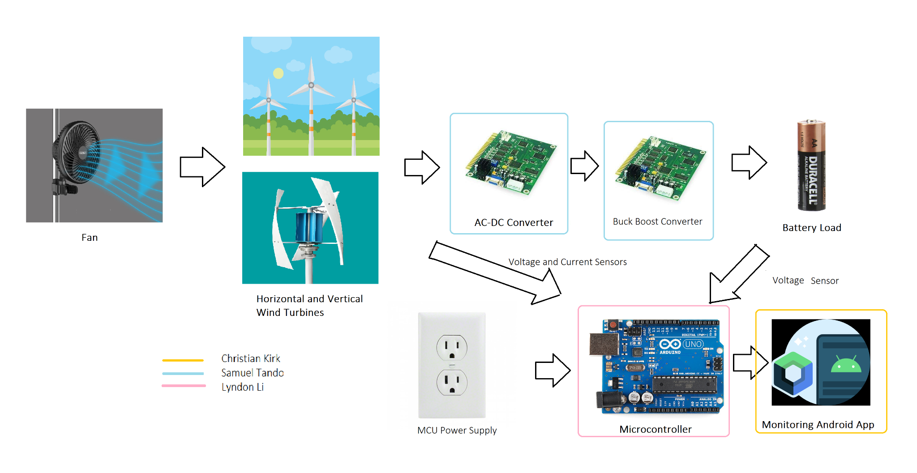
System Block Diagram
Charge Switch
Charge Switch

Slide 4
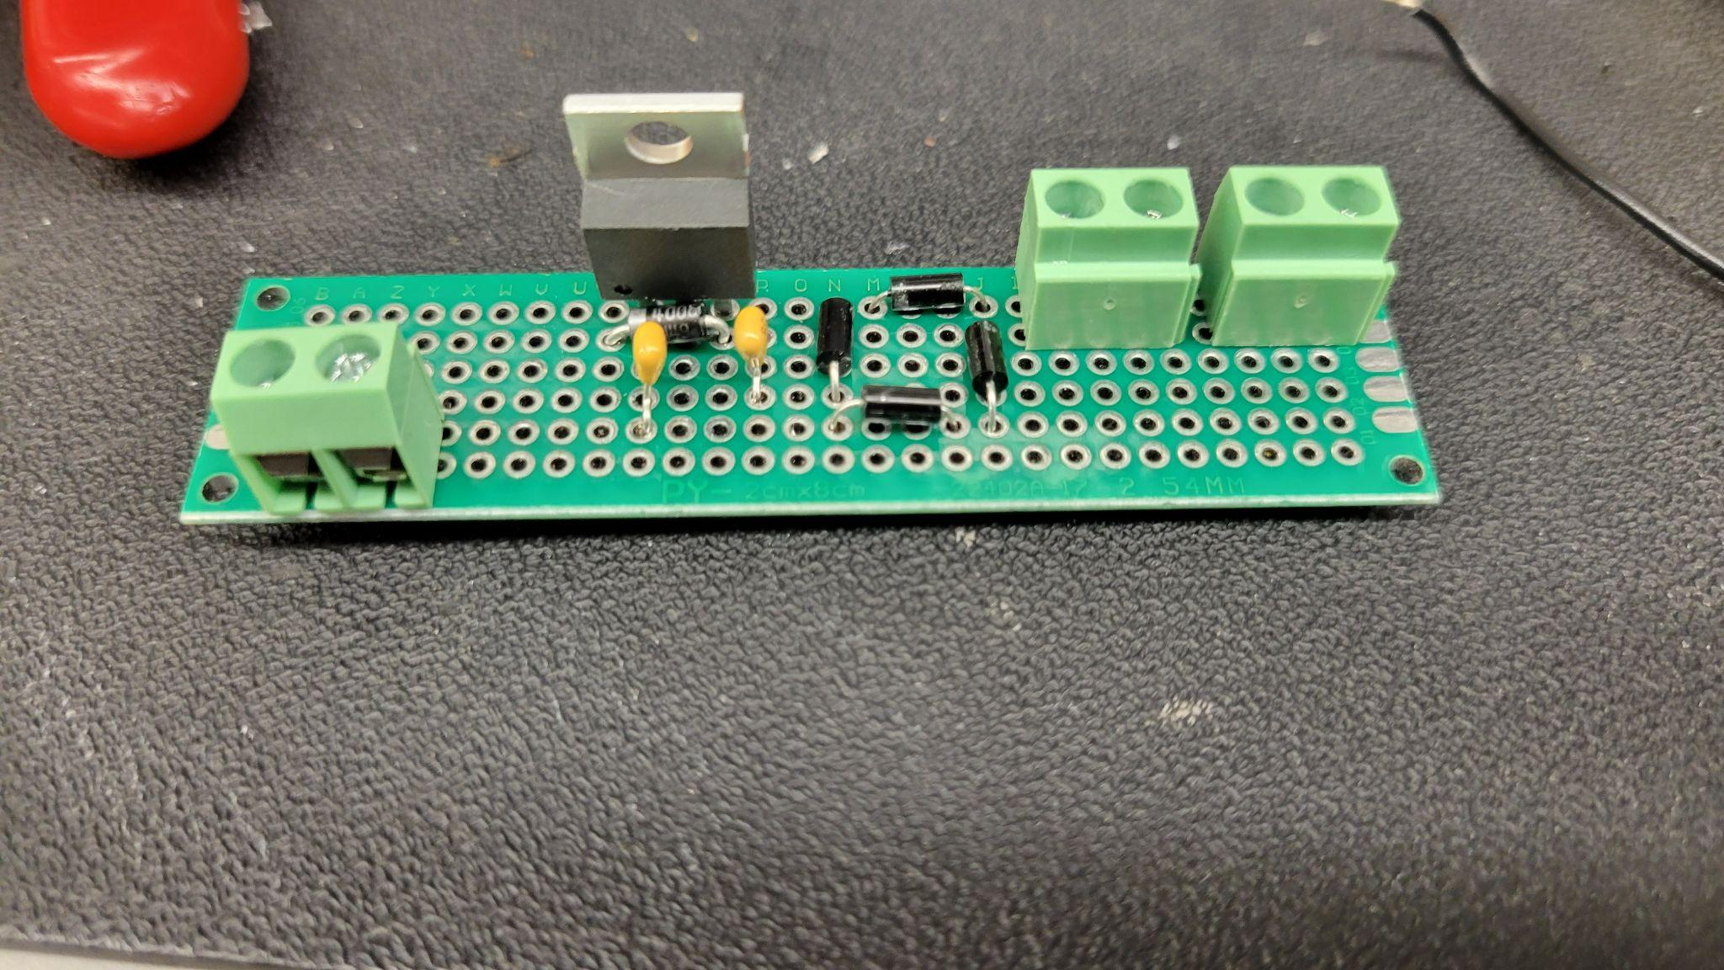
Power Subsystem- Samuel
403 Deliverables:
Convert AC generator from 0-8V to 5V DC voltage
DC to DC converter from 5V to 8.4 V output to safely charge 9V battery
PCB Design

Slide 5
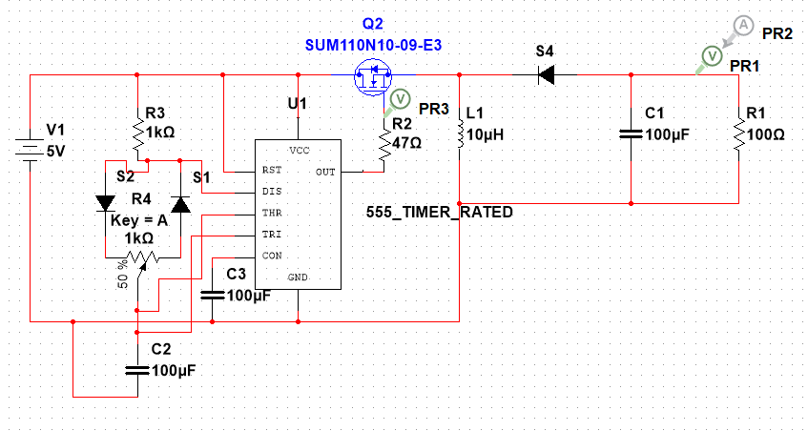
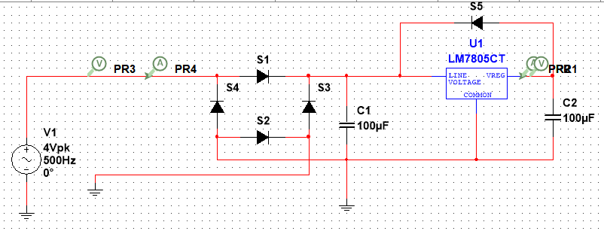
Power Subsystem
Summary
Finished AC/DC Design and PERF board
Finished Buck Boost Design
Finished AC/DC PCB design

Slide 6
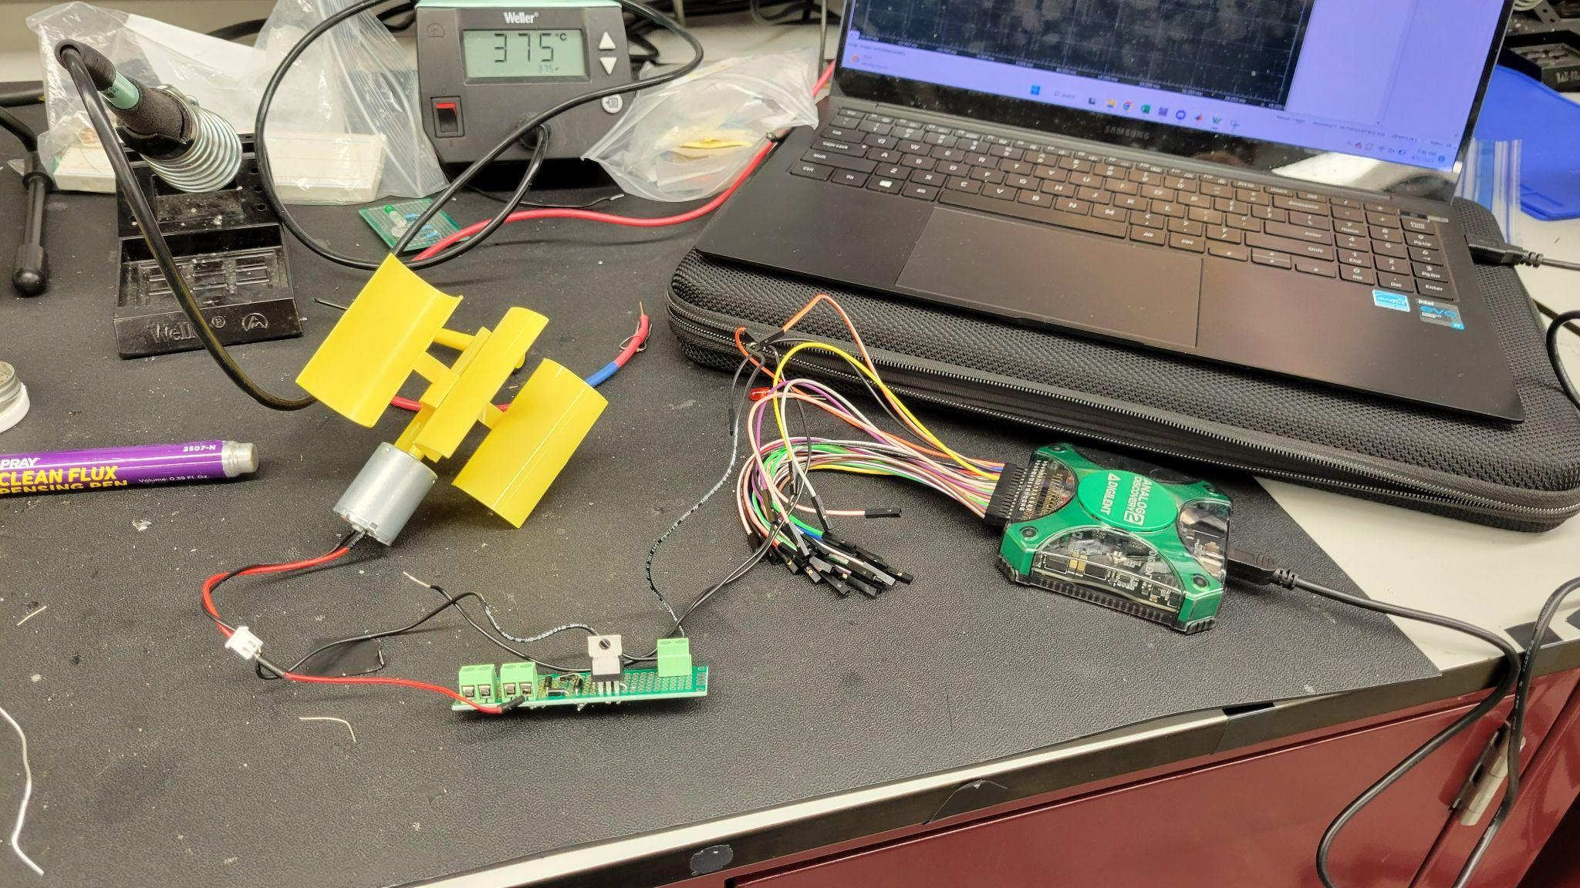
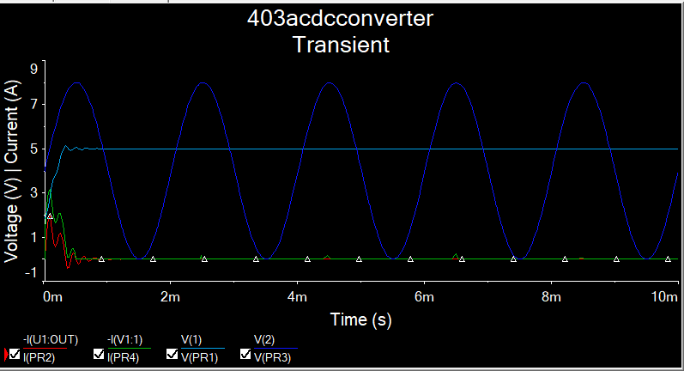
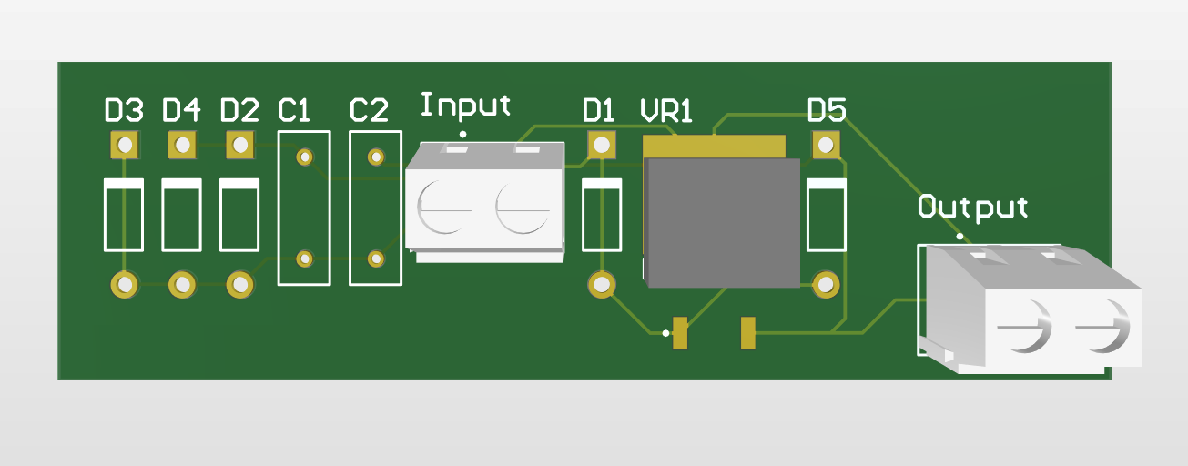
Power Subsystem Testing/Validation
AC/DC
Input: 0-5V | Simulated Output: 2.83 V Perfboard Output: 2.58 V
Input 0-8V | Expect Output: 5V Simulated Output: 5.008 V Perfboard Output: 4.64 V

Slide 7
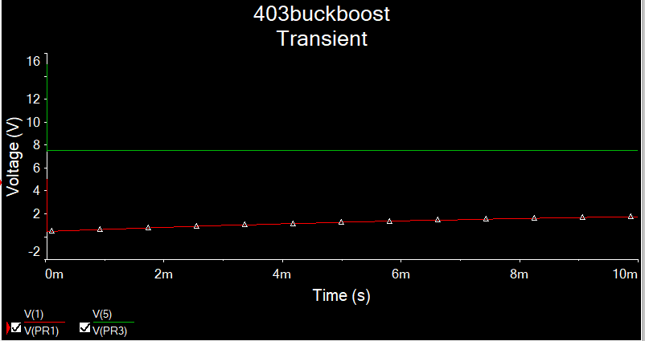
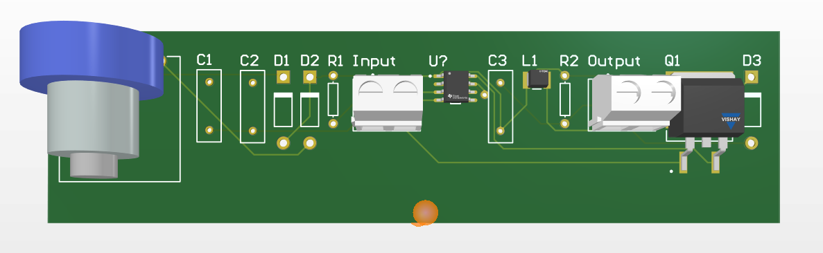
Power Subsystem Testing/Validation
Buck Boost Converter
Input Voltage: 5V
Expected Output:
8.4 V
Simulated Output:
7.5V

Slide 8
Power System Future
403
Order PCBs
Solder Buck Boost Perf Board
Test both AC/DC and Buck boost together
404
Apply circuits to both turbines
Add battery load to system
Integrate with MCU
Add more safety features

Slide 9
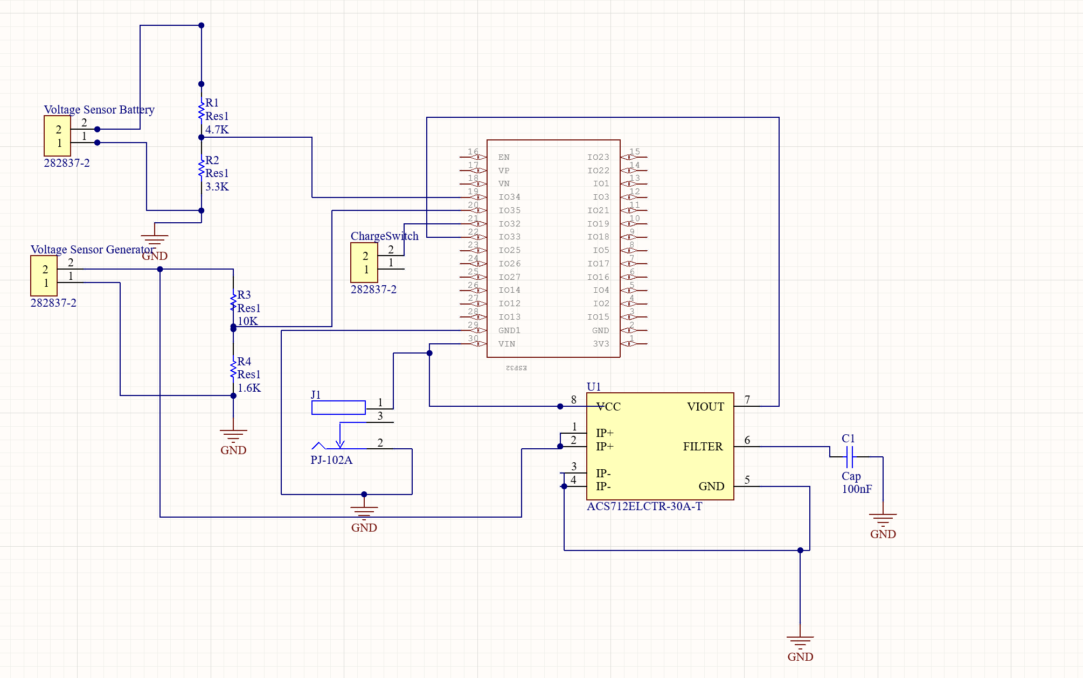
MCU Subsystem Overview- Lyndon
403 Deliverables:
-Voltage sensor for battery and generator
-Output signal for buck-boost converter switch
-Data exchange through bluetooth
-Current sensor for power calculation
-PCB Design

Slide 10
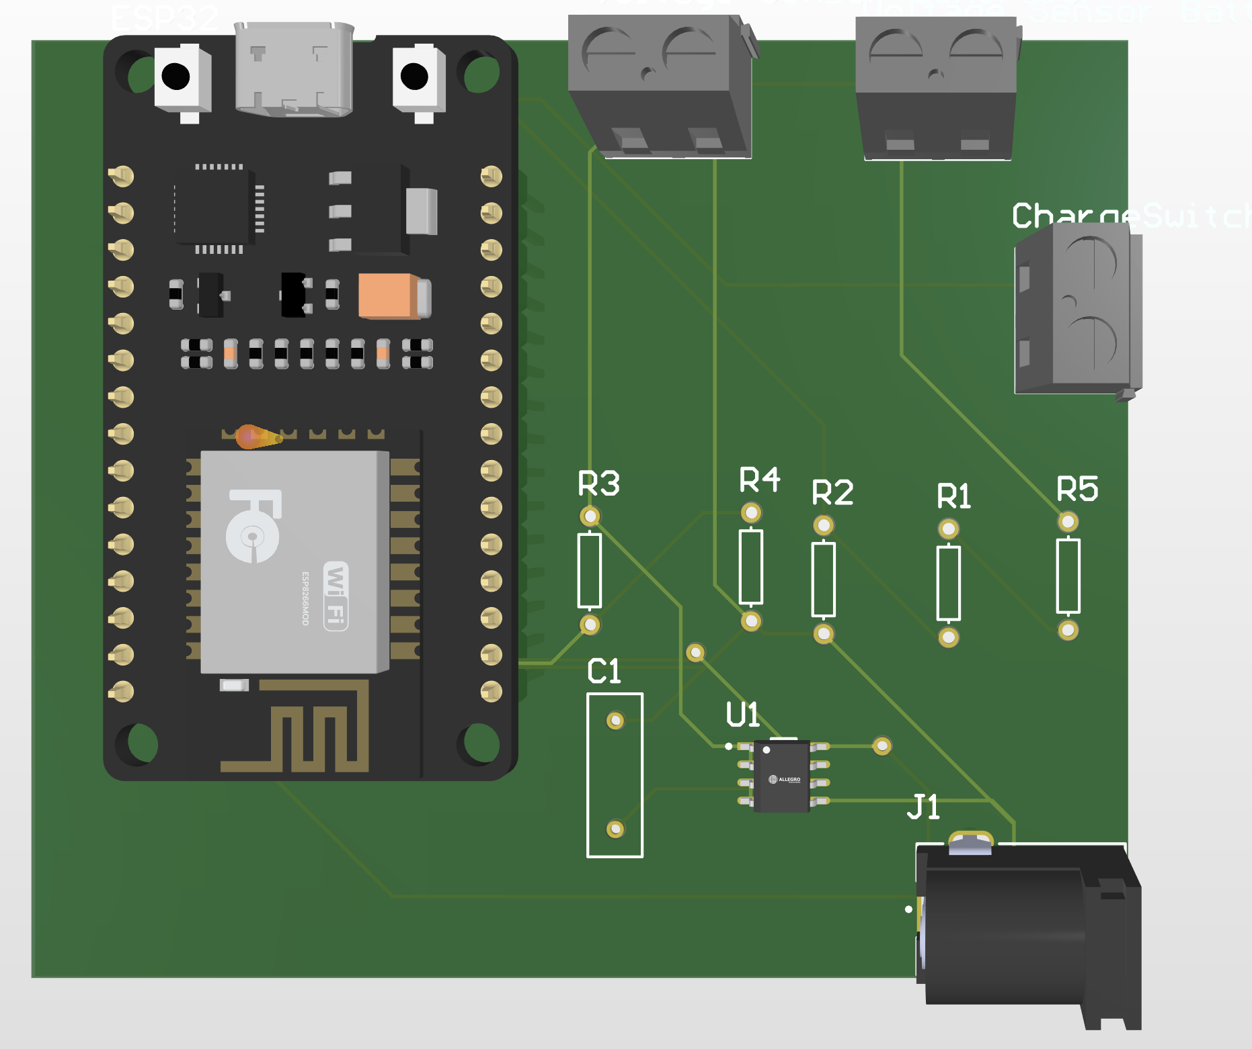
MCU Subsystem Summary
-Added current sensor for power calculation
-Completed bluetooth data transfer code
-Completed Charge control function
-Completed Battery Level function

Slide 11
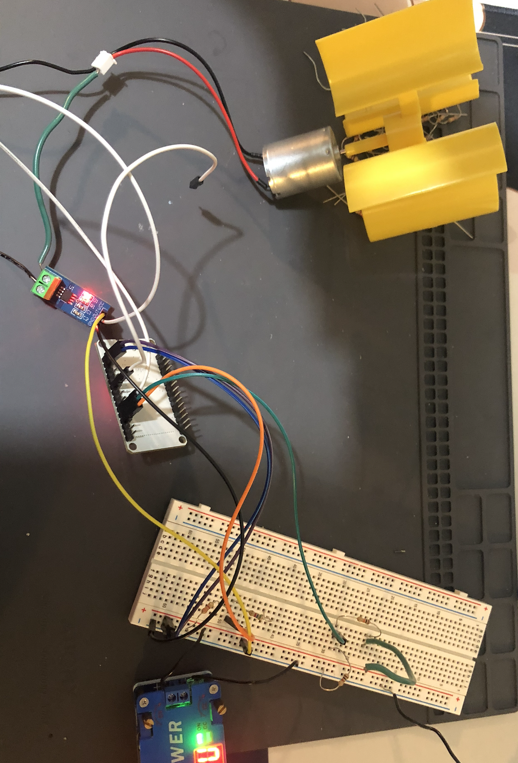
MCU Subsystem Test/Validation

Slide 12
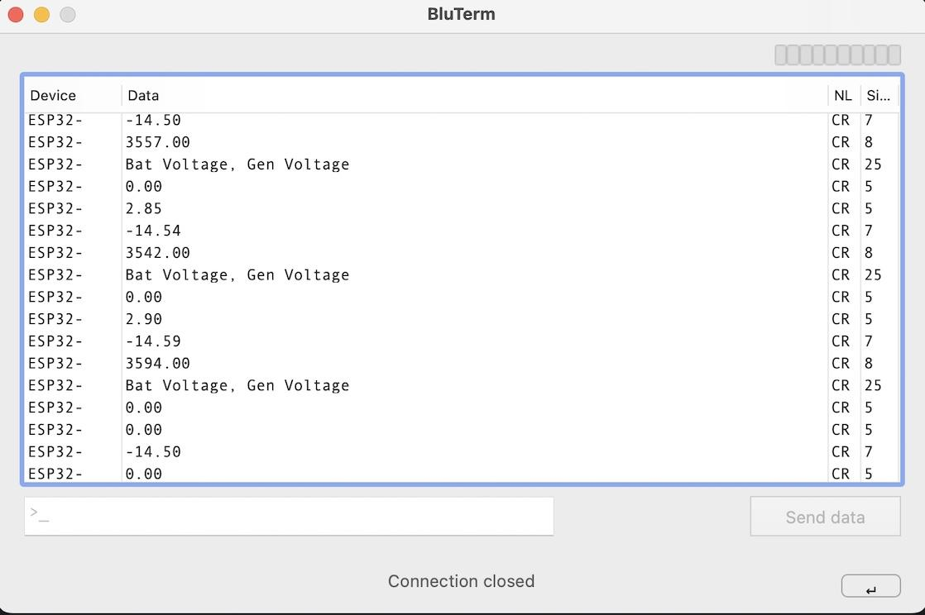
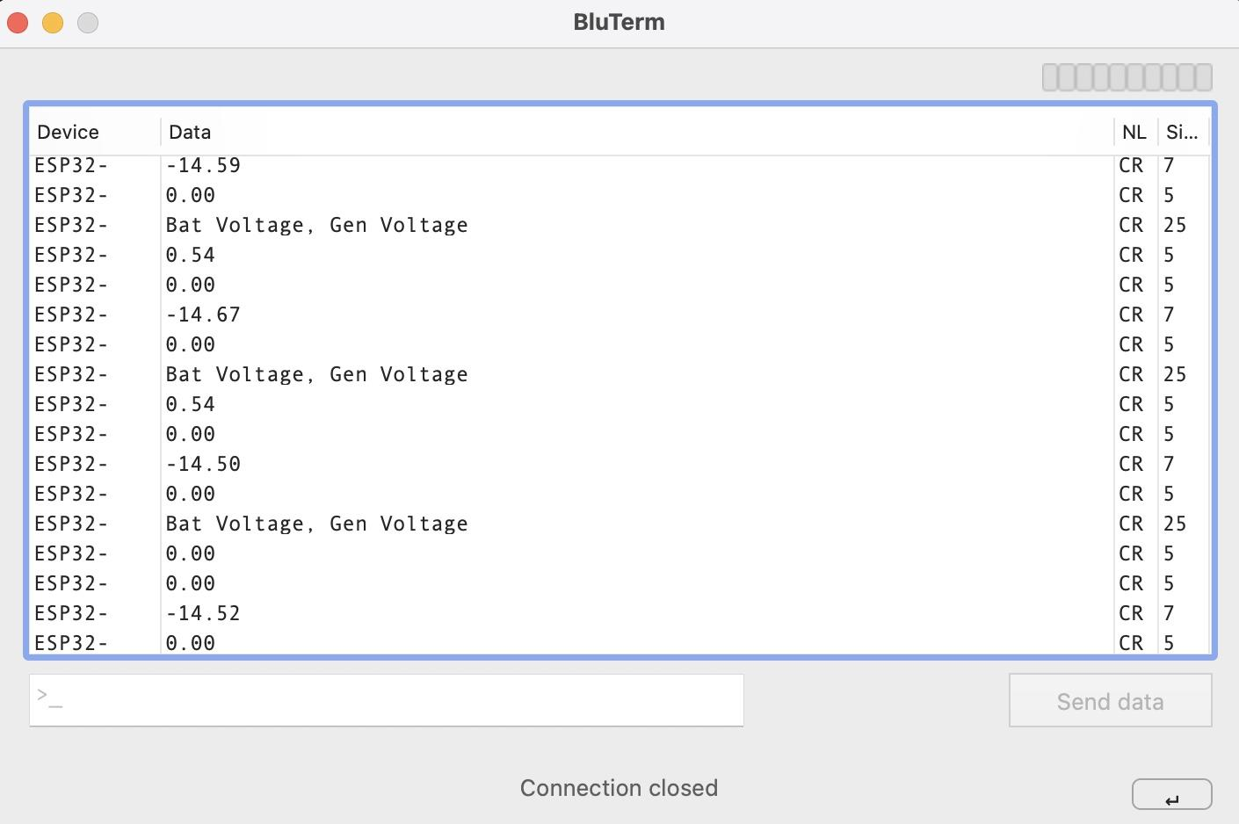
MCU Subsystem Test/Validation
Expected Actual
2.86 2.85
0.68 0.54

Slide 13
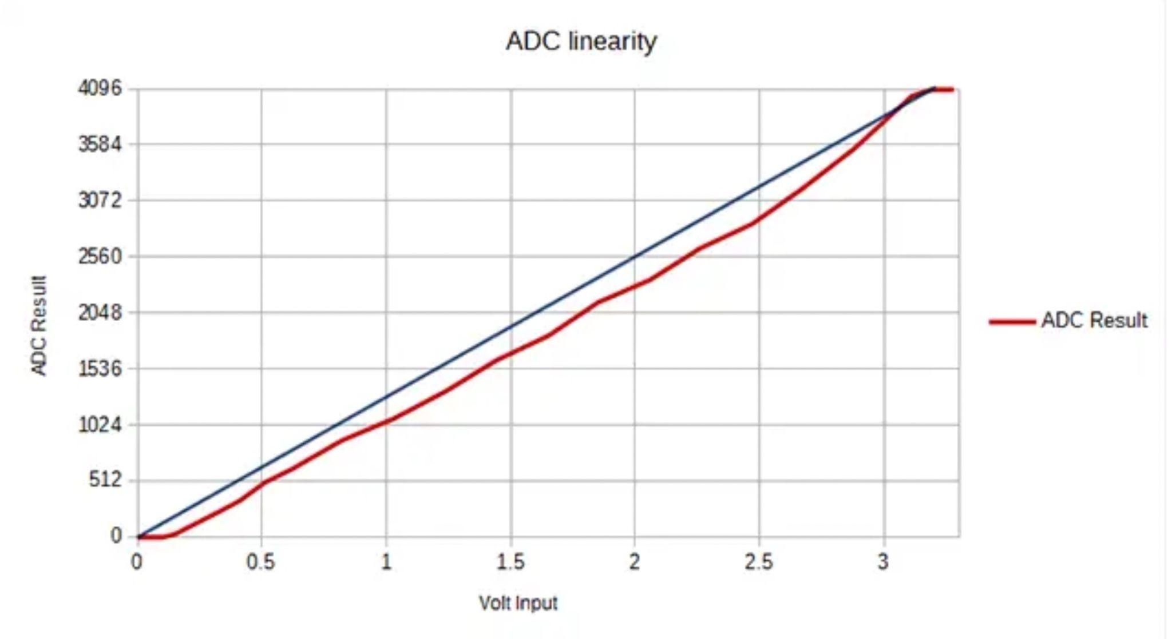
MCU Subsystem Future
403
-Tweak sensor voltage formulas to account for nonlinear values
-Validate current sensor readings are correct
-Solder everything onto PCB

Slide 14
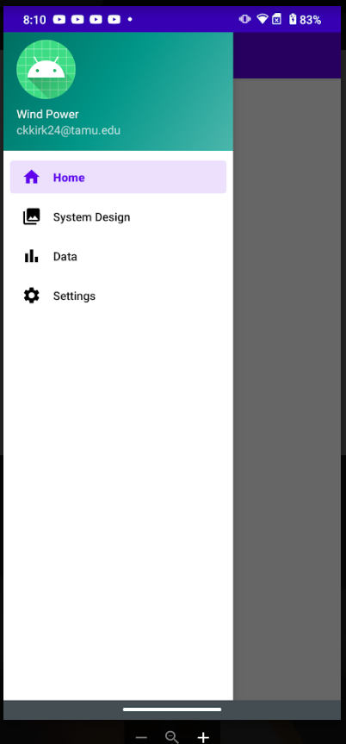
App Subsystem Overview- Christian
403:
Create UI
Code for BT connection
Four Pages:
Display battery charge level
Interactive wind power system
Plot battery charge level over time
Allow user to set max battery charge level

Slide 15
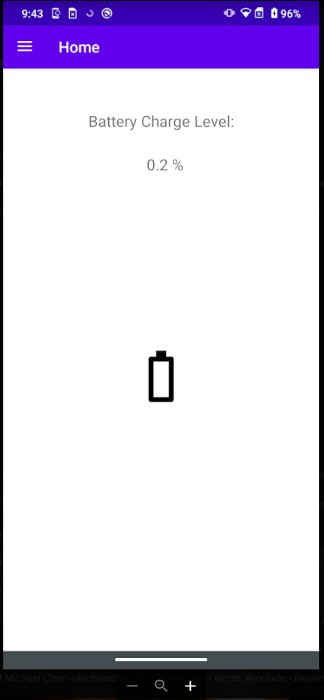
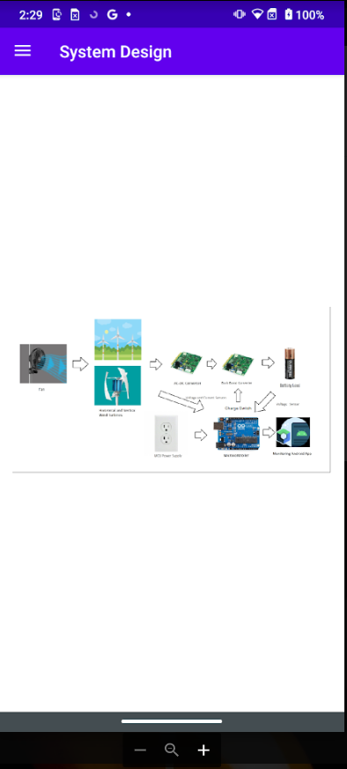
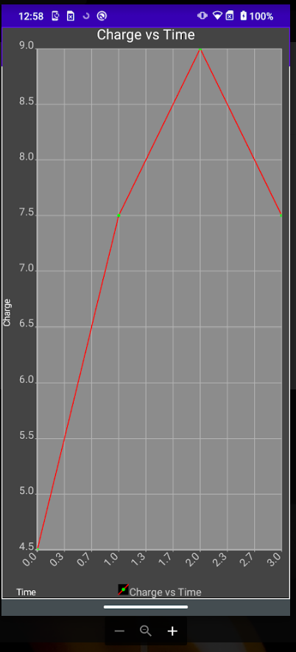
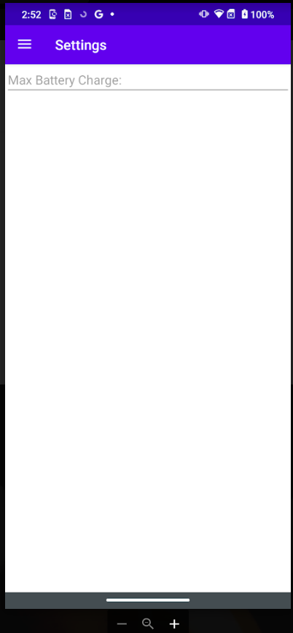
App Subsystem Overview

Slide 16
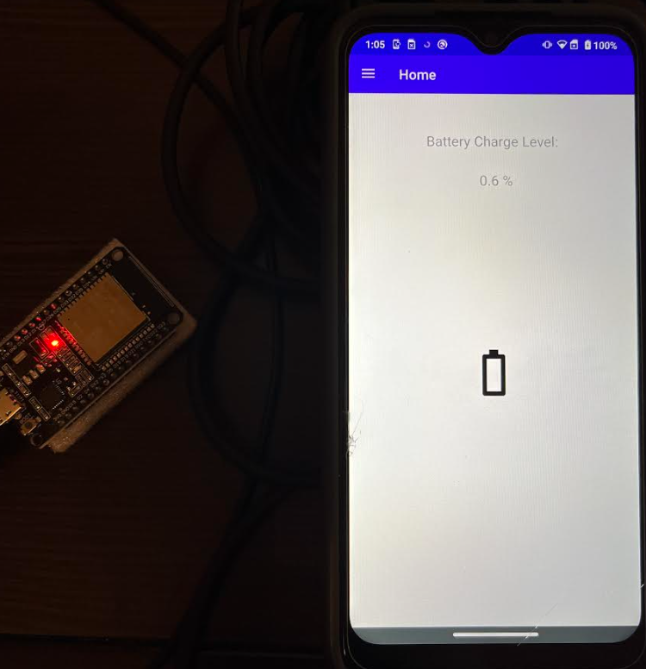
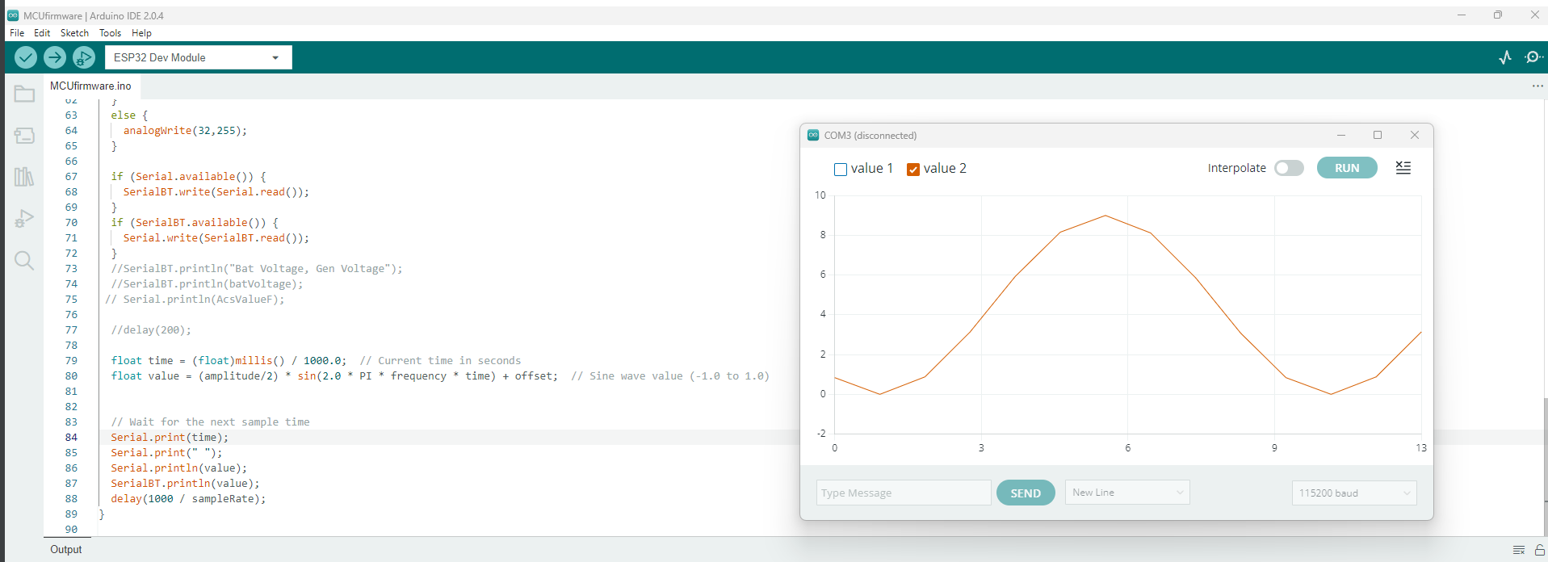
App Subsystem Testing/Validation
Arduino IDE Sine wave Test stimulus
9V amplitude for simulation

Slide 17
App Subsystem Future
Rest of 403:
Better image for System Design page
Clean up plot on Data page
Validate max charge level on Settings page
404:
Swap simulated data with actual measured values from MCU

Slide 18
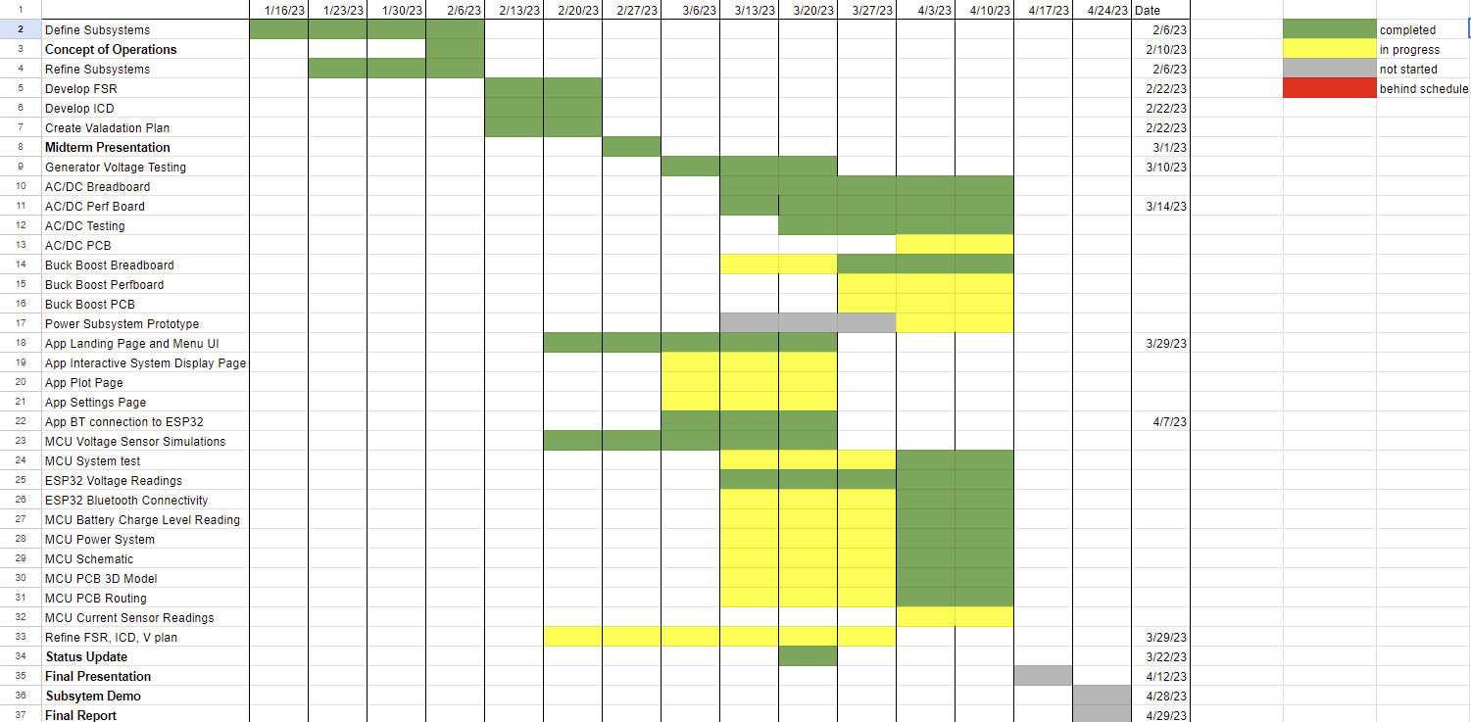
Execution Plan

Slide 19
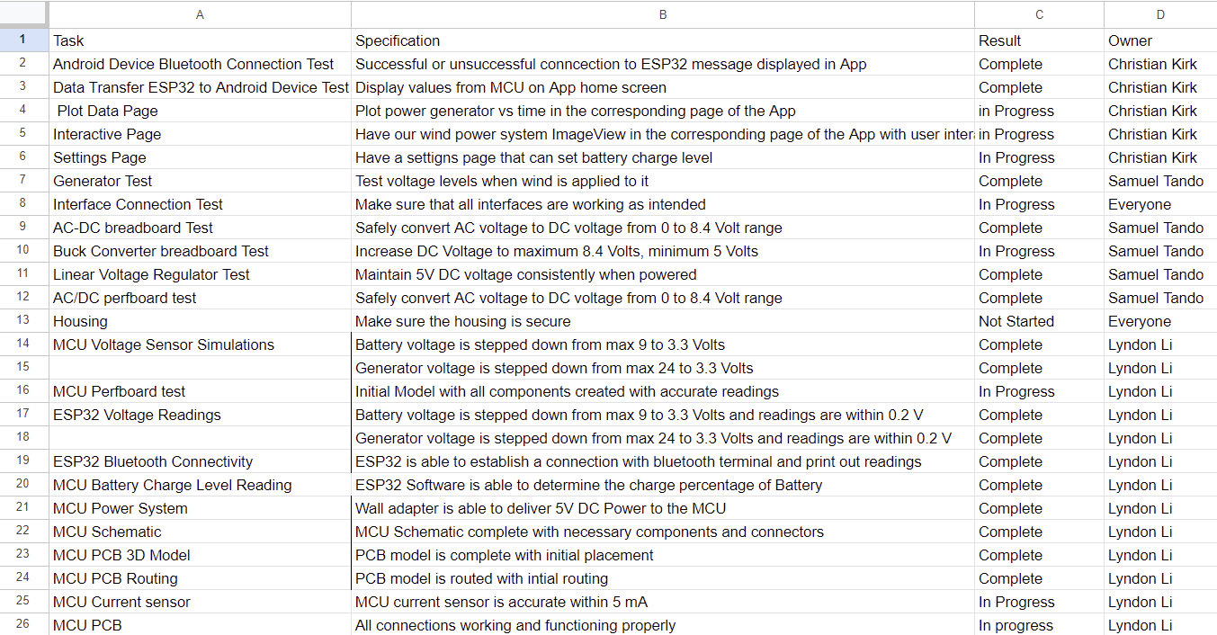
Validation Plan

